Slide 1
INSTRUCTIONS TO ALL CANDIDATES AFTER FIRST ROUND SEAT ALLOTMENET PROCESS.
ONLINE NON-INTERACTIVE COUNSELLING
DEPT OF TECHNICAL EDUCATON

Slide 2
1) VISIT www.dte.kar.nic.in EVERY DAY FOR KNOWING ALLOTMENT PROCESS.
2) All the allotted candidates are informed to do the choice entry from 20th to 22nd June 2015 compulsorily to confirm the seat already allotted or to participate in the second round of allotment.
3) While making choice entry, candidates has to enter the OTP (One Time Password) they receive to their registered mobile from DM-KEAKAR for confirming your choices compulsorily. If you are unable to get the OTP for any reason, you are allowed to update the mobile details in the candidate portal.
4) From 23rd to 29th June 2015, those who have entered choice 1 and choice 2 are informed to report to the allotted college and pay the prescribed fees and obtain admission order/fee payment order. Who have confirmed his/her seat allotment by entering choice-1 they have to report to the allotted college on before 29th June 2015 otherwise the seat will be cancelled with all the original documents and 1 Xerox copy.
5) Students who have entered choice-2, he may re-order his/her options already entered in the second round.

Slide 3
For example: A candidate might have been allotted 6th priority as under
CET_NO OPTION_CODE PRIORITY_NO
100051 E150CE 1
100051 E185ce 2
100051 E185CS 3
100051 E185ME 4
100051 E311EE 5
100051 E342CE 6 ( currently allotted in the first round)
100051 E342CS 7
Suppose you have entered choice-2, then you are allowed to re-order the option entries above the priority number 6 only. You may change in any order like 1 as 3, 5 as 2 and so on vice-versa.
6) Who-ever not got the seat in the first round of allotment, you are allowed to participate in the second round of seat allotment with fresh option entries from 2nd July to 5th July.
7) Already who got the seat and entered choice-3 they are also allowed to participate in the second round of seat allotment with fresh option entries from 2nd July to 5th July.

Slide 4
URL DETAILS FOR TO REACH WEBSITE OF NON INTERACTIVE DIPLOMA ADMISSION 2015-16
http://164.100.133.129:83/Diploma
http://164.100.133.129:83/index

Slide 5
ADMISSION SCHEDULE
ALLOTMENT RESULT WILL BE PUBLISHED ON
2015, JUNE ,20th before 7:00 PM.
ALLOTMENT STATUS WILL BE SENT TO STUDENTS THROGH SMS.
DATES FOR THE CANDIDATES TO
To ENTER THEIR CHOICE ENTRY TO CONFIRM THE SEATS ALLOTTED TO THEM IS FROM 2015, June 21st To 2015, June 22nd
To Pay Fees FROM 2015, June 23rd To 2015, June 29th
Option Entery FROM 2015, July 2nd To 2015, July 5th
2nd Round Allottement 2015, July 7th
2nd Round Admission From 2015, July 8th To 2015, July 11th

Slide 6
CHOICE ENTRY
FROM 21st JUNE 2015 to 22nd JUNE 2015 CANDIDATES ARE ALLOWED TO CONFIRM THEIR ALLOTTED SEATS BY LOGGING IN TO THEIR CANDIDATE PORTAL BY USING THEIR SECRET KEY AND PASWORD. CANDIDATES CAN ALSO CONFIRM THEIR ALLOTTED SEATS FROM ANY OF OUR 125 HELPLINE CENTERS.
NOTE:
THE CANDIDATES SHOULD CONFIRM THEIR ALLTTED SEATS ON OR BEFORE 22nd JUNE 2015 COMPULSORILY, OTHER WISE ALLOTTED SEAT TO THE CANDIDATE WILL DEEMED TO BE CANCELLED.

Slide 7
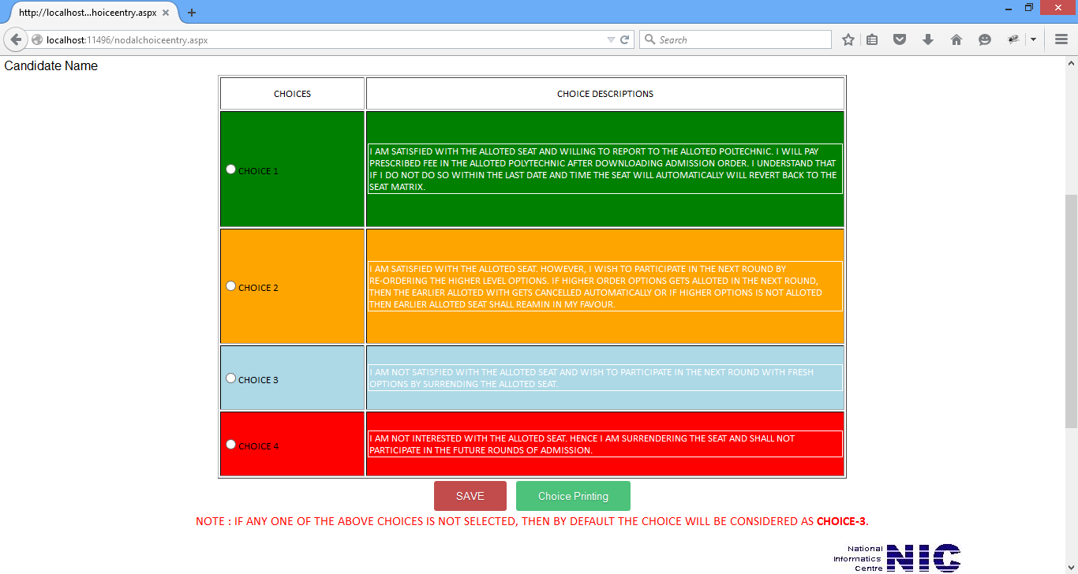
CHOICE ENTRY TYPES

Slide 8
IF THE CANDIDATE CONFIRM CHOICE 1
Then the Candidate is satisfied with allotted seat and willing to join by paying the prescribed fee in the allotted Polytechnic on or before 29th June 2015 .
If the Candidate does not Pay the fees on or before 29th June 2015 , then the seat allotted to the candidate will be cancelled .

Slide 9
IF THE CANDIDATE CONFIRM CHOICE 2
Then the Candidate is satisfied with allotted seat and willing to participate in the next round for better option by re-altering the option entries of higher priority by paying the prescribed fee on or before 29th June 2015 in the allotted Polytechnic.
If the Candidate does not Pay the fees on or before 29th June 2015 , then the seat allotted to the candidate will be cancelled .

Slide 10
IF THE CANDIDATE CONFIRM CHOICE 3
Then the Candidate is not satisfied with the allotted seat and willing to participate in the next round by re-entering fresh options by surrendering the allotted seats.
i.e. The seat allotted to the candidate will be cancelled

Slide 11
IF THE CANDIDATE CONFIRM CHOICE 4
Then the Candidate is not willing to join Diploma and not interested to participate in any further rounds by surrendering the allotted seat.

Slide 12
CHOICE ENTRY CONFIRMATION
Candidates can change their choice entry till the last date.
Last Date for choice entry is 22nd June 2015 8.00 Pm
Their last choice will be considered as their choice confirmation for allotted seat next session/round allotment
After 22nd June 2015 8.00 Pm candidates are not allowed to change their choice option.

Slide 13
CHOICE ENTRY AT NODAL CENTERS
If the candidate needs help to confirm their choice , the candidate can visit the nearest nodal center for help .
The candidates should carry their Mobile to the Nodal center compusorily. (OTP WILL BE ISSUED TO THERE REGISTERED MOBILE NUMBER).

Slide 14
ADMISSION and FEE PAYMENT ORDER
Candidates those who have chosen CHOICE -1 can download the Admission order after paying the Fee at the allotted poly technic.
Candidates those who have chosen CHOICE -2 will be issued Fee Payment order after paying the Fee at the allotted polytechnic.
If the Candidates does not Pay the fees on or before 29th June 2015 , then the seat allotted in round - 1 to the candidate will be cancelled .

Slide 15
SECOND SESSION OF ALLOTMENT
Second Round Seat – Matrix will be Announced on 1st july 2015
The candidates can enter Option Entry from 2nd july 2015 to 5th july 2015
If the Candidate had chosen choice 2, then the candidate is allowed only to Re-Order the higher priority options only.
If the Candidate had chosen choice 3, then the candidate is allowed Re-Order and also to enter fresh options .

